Slide 1
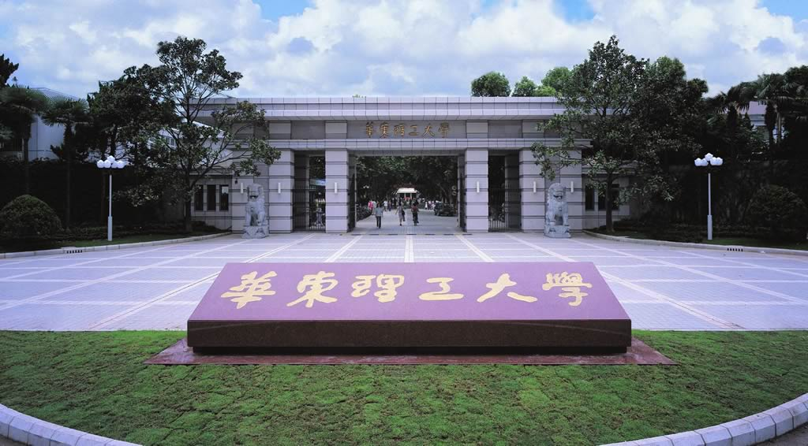
Proteomics
（ 2 credits）
Li-Qiang Fan
East China University of Science and Technolog

Slide 2

Textbook
Concepts and techniques in genomics and proteomics
Nachimuthu Saraswathy and
Ponnusamy Ramalingam
Woodhead Publishing 2011
Notes:
http://www.doc88.com/p-1344878188464.html
https://www.sciencedirect.com/science/article/pii/B9781907568107500213

Slide 3
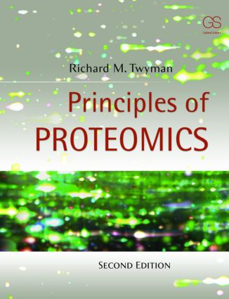
Textbook
Principles of Proteomics
2nd Edition
Richard Twyman
Garland Science 2013
ISBN-13: 978-0815344728
ISBN-10: 0815344724
Notes:
、https://nptel.ac.in/courses/102/101/102101007/ Proteomics: Principles and Techniques

Slide 4

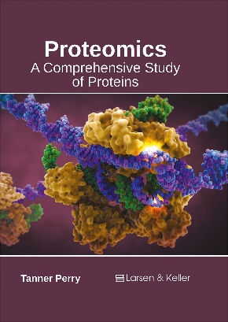
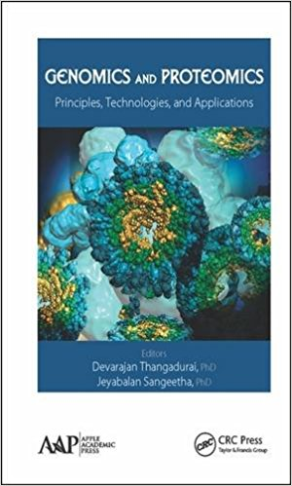
Reference books
Key Concepts of Proteomics （Charles Malkoff. Callisto Reference 2015）
Proteomics A Cold Spring Harbor Laboratory Course Manual
Proteomics: Targeted Technology, Innovations and Applications. （Caister Academic Press 2014）
Proteomics: A Comprehensive Study of Proteins（Larsen and Keller Education; Comprehensive 2017 ）
Genomics and Proteomics: Principles, Technologies, and Applications（ Apple Academic Press Inc. 2015）
Notes:
Syllabus

Slide 5
Course contents
Introduction to Proteomics
The orgin of proteomics
Basic Concepts
Why proteomics?
Scope of proteomics
Key technologies in proteomics
Expression Proteomics
Sample preparation
Technique for Proteome Separation
Two Dimentional Electrophoresis (2DE)
Problems of 2DE and solving methods
Non-gel based separation methods
Protein image analysis in Proteomics
Protein Identification
Traditional identification Technology
MS Introduction
MS-based identification Technology
Quantitative and Differential Proteomics
Gel-based Quantitative and Differential Proteomics
MS-based Quantitative and Differential Proteomics
Interaction Proteomics
Hybrid System
Surface display system
Affinity-based Protein-Protein Interaction Study
Fluorescence based Protein-Protein Interaction Study
Application of Proteomics
Proteome research in various types of organisms
Proteomics and disease
Proteomics and drug research
Notes:
Syllabus

Slide 6
Course Plan
Chapter | Contents | Class Hour
1 | Introduction to Proteomics | 2
2 | Sample preparation | 4
3 | Technique for Proteome Separation | 6
4 | Image analysis in Proteomics | self- study
5 | Protein Identification | 6
6 | Quantitative and Differential Proteomics | 4
7 | Methods for Protein-Protein interaction study | 10
8 | Application of Proteomics | self- study
Notes:
Syllabus

Slide 7
课程安排
第一章 蛋白质组学简介 （2学时）
第二章 蛋白质样品的制备 （4学时）
第三章 蛋白质组样品分离技术 (6学时）
第四章 蛋白质组研究中的图像分析 （自学）
第五章 蛋白质的鉴定技术 （6学时）
第六章 定量蛋白质组学研究技术 （4学时）
第七章 蛋白质相互作用研究技术 （10学时）
第八章 蛋白质组学的应用实例 （自学）

Slide 8
Proteomics Course Evaluation
Attendance 10%
Homework and quiz 20-30%
Literature reading and discussion 10%
Final examination 50-60%
Notes:
被动学习 passive learning Difficulty in learning and understanding
https://www.baidu.com/link?url=ONj-qej3IPuowE61dgJh7wRWXK0c5UMCO98qnUMEBxBkH_DDsYH0-3GxL_QLS8dqm8e1wo_WTm7_c65YWrdDX3U4uGP0XKdZb4-H1DqaVSA96SxcMx32-oyqFUy4rin8&wd=&eqid=cc8db2b60001bdff000000045b05893d

Slide 9
Chapter 1 Introduction to Proteomics
The orgin of Proteomics
Basic concepts
Character of Proteome
Importance of proteome study
Scope of proteomics
Notes:
回顾所学知识点
分子生物学定义
分子生物学发展简史
分子生物学研究内容
分子生物学展望
目前，有关生物化学的研究主要集中在以下几个方面：
生物大分子的结构、功能与相互作用
基因组学和蛋白质组学
基因表达的调节
细胞信号的传导
生物工程学

Slide 10

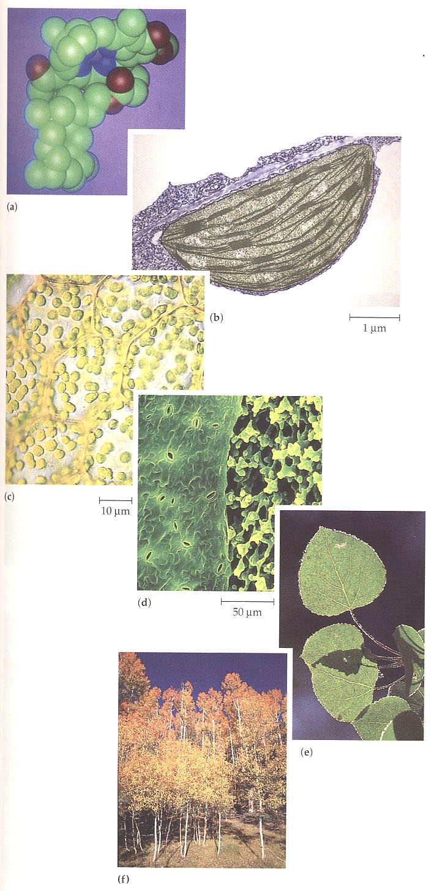
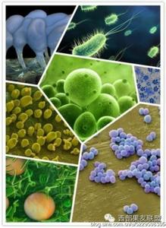
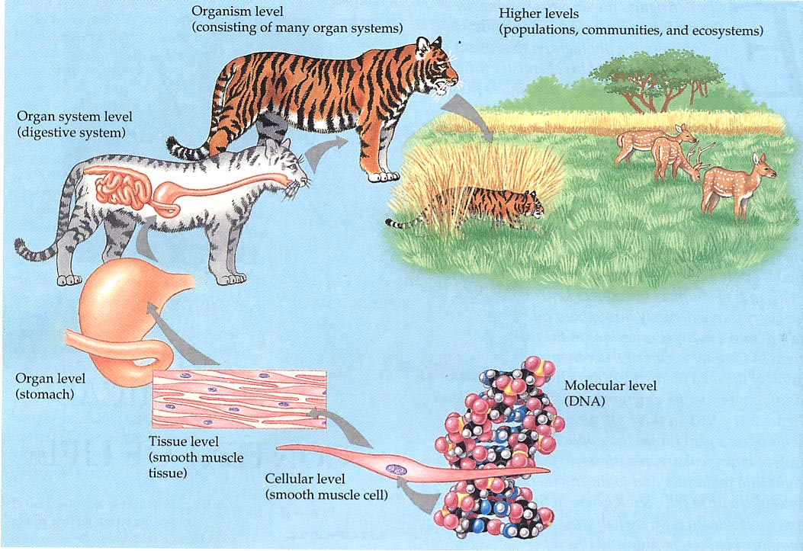
1.1 The orgin of proteomics The hierarchy of biological organism
From “molecule” to “organism” to “Ecologies”
Notes:
生物学是研究生命现象及其活动规律的科学。随着生物学的迅猛发展以及研究在分子层面上的切入，人们从微观角度对生物体有了更加系统和深入的认识。
19世纪后期→20世纪50年代 现代分子生物学的开始阶段 1）明确了蛋白质是生命的主要基础物质；2）确定了生物遗传的物质基础是DNA
20世纪50年代 → 20世纪70年代初 现代分子生物学的建立与发展阶段 1）建立遗传信息传递的中心法则；2）对蛋白质结构域功能的进一步认识
20世纪70年代以后初步认识生命本质并进入开始改造生命的深入发展阶段

Slide 11
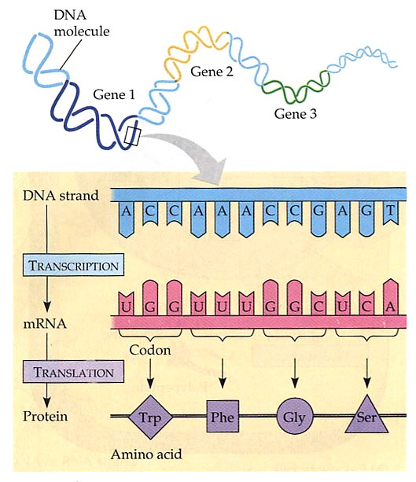
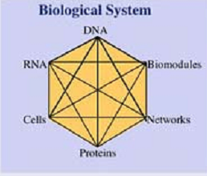
Levels of biological information
DNA
mRNA
Protein
Metabolites
Pathways
Networks
Cells
Organs
Individuals
Populations
Ecologies

Slide 12

Traditional Bioscience studies ---Reduction approach
Divide biosystem into its components
Study different “parts” individually, especially single gene or single protein
Reassemble these components into a system from the bottom up
Hypothesis-driven
Give a hypothesis to a phenomena, then prove it or deny it by experiments

Slide 13

Traditional protein studies
Target : single protein
Core: structure and function
Problem: diversity, difficult to purify, easily inactive, techniques
Protein→gene

Slide 14

Traditional gene function studies
Forward genetics
Using an observed mutant phenotype (or purified protein) as the starting point to map and identify the corresponding gene, then functional analysis this gene and its product
Reverse genetics
Take an uncharacterized gene sequence and modify it to see the effect on phenotype
Knock out Knock in

Slide 15
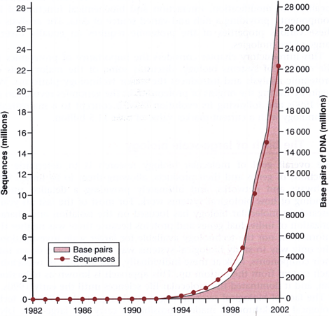
large-scale sequencing on model organisms since 1990
1980-1990: steady growth of sequence data;
Since 1990s: massive explosion of sequence data
EST/random sequencing
large-scale sequencing
1995 Haemophilus influenzae
1996 Saccharomyces cerevisiae
2003 Human genome
Notes:
In the early 1990s, much of the new sequence data was represented by expressed sequence tags (ESTs), short fragments of DNA obtained by the random sequencing of cDNA libraries. In 1995, the first complete cellular genome sequence was published, that of the bacterium Haemophilus influenzae. In the next few years, over 100 further genome sequences were completed, including our own human genome which was essentially finished in 2003.

Slide 16



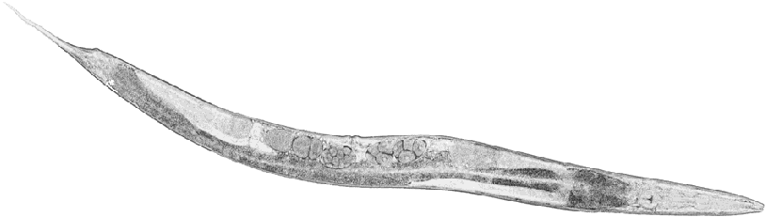
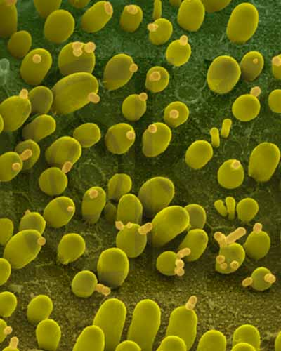
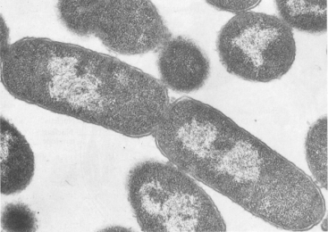
Genome sequencing
1995.7 first complete cellular genome—Haemophilus influenzae (流感嗜血杆菌) 1.8 Mb
1996 Saccharomyces cerevisiae
2000.3 fruit fly Drosophila melanogaster (果蝇) ,180-Mb, the largest genome
2000.12 the first plant, Arabidopsis thaliana (拟南芥) 125 Mb
2001.10 rice genome sequencing begins/ 2002 draft sequence obtains
2001.2 Human and Celera draft sequence
2002 75 organisms genome complete
2003.4 Human Genome Project complete
2008.1 706 organisms genome completed,
2654 organisms genome ongoing
2011.4 1009 organisms genome completed
928 organisms genome draft assembly
942 organisms genome ongoing
Notes:
2001年底， 人类基因组测序全面完成， 这预示着生物科学研究的一个新领域的开始，而实际上所完成的还只是构成人类46条染色体的基因的四种核苷酸排列顺序，该序列中保存了人类代代相传的信息， 生命体活动的本质蛋白质及其构成组织和器官的所有信息

Slide 17
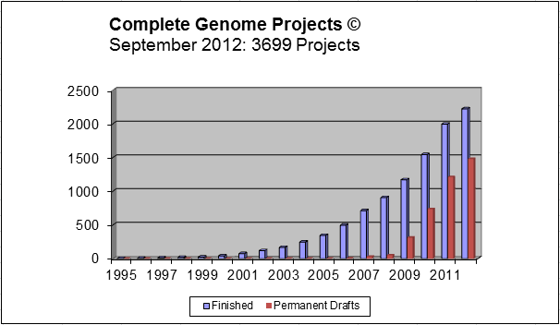
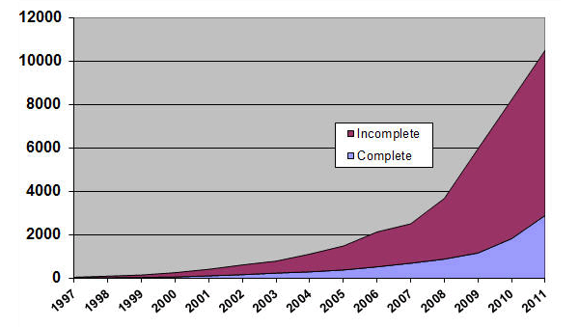
Completely Sequenced Genomes
October 2011, 10031 projects
Genome Sequencing Projects on GOLD
http://www.genomesonline.org/cgi-bin/GOLD/index.cgi?page_requested=Statistics

Slide 18
Complete Published Genome Projects: 1217
Bacteria (1013)
Archaea (80)
Eukarya (124)
On going Genomes：5510
Bacteria (3984)
Archaea (202)
Eukarya (1324)
( http://www.genomesonline.org/
Last Update: January 24, 2010)

Slide 19
Complete Published Genome Projects: 3173
Bacteria (2847)
Archaea (153)
Eukarya (173)
On going Genomes: 10479
Bacteria (7908)
Archaea (213)
Eukarya (2385)
( http://www.genomesonline.org/
Last Update:March 12, 2012)

Slide 20
( http://www.genomesonline.org/
Last Update: Feb 25, 2013)
Complete Published Genome Projects: 4136
Bacteria (3771)
Archaea (182)
Eukarya (183)
Finished: 2408
Permanent Draft: 1728
Finished: 2408
Permanent Draft: 1728
On going Genomes ：17187
Bacteria (14226)
Archaea (260)
Eukarya (2741)
Complete but not published: 40
Draft: 3225
In Progress: 9013
DNA Received: 173
Awaiting DNA: 332

Slide 21
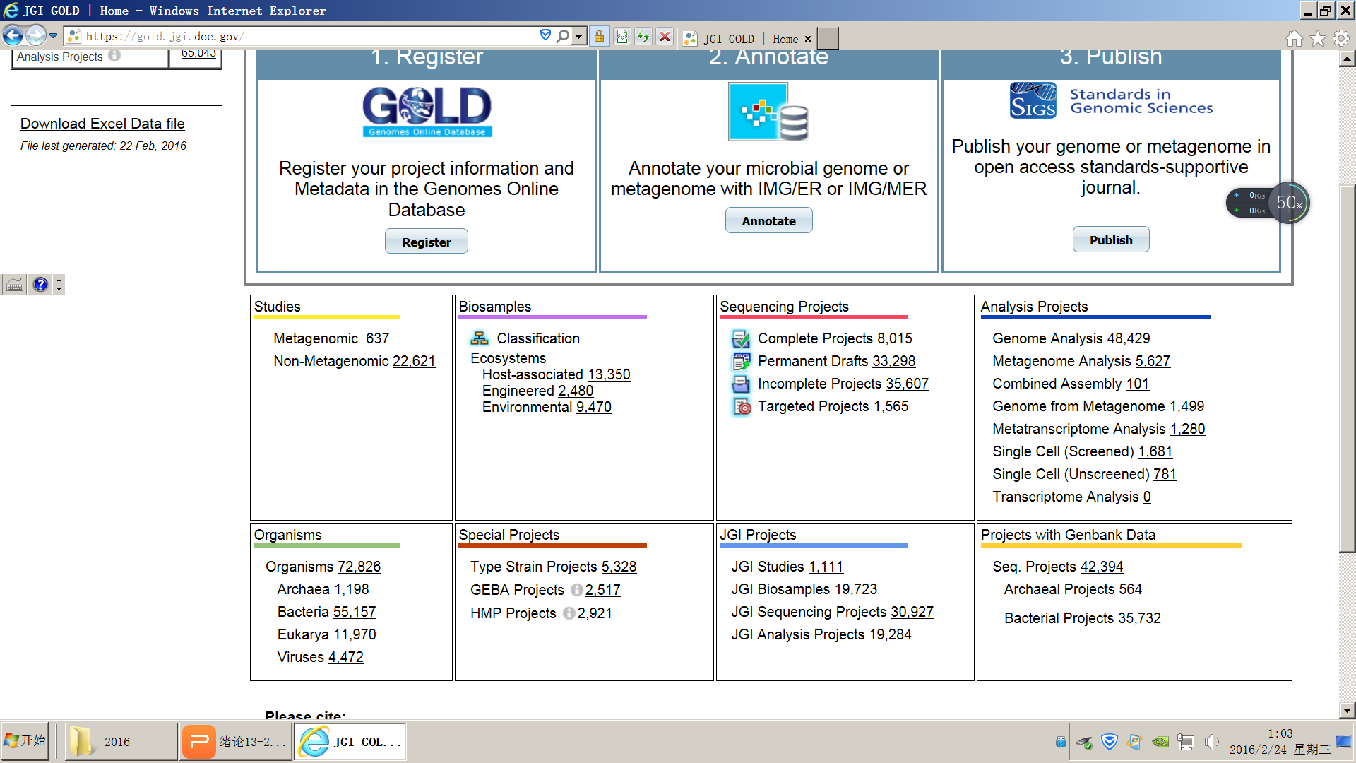

Slide 22
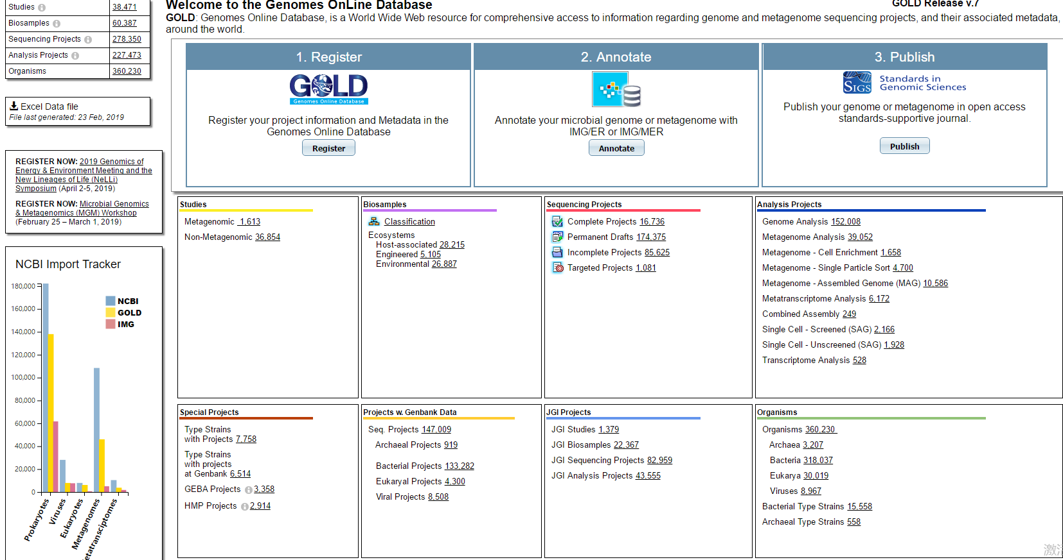
2019.2.24

Slide 23
 | complete | ongoing | draft-assembly
2008 | 706 | 2654
2010 | 1217 | 5510
2012 | 3173 | 10479
2013 | 4136 | 17187
2016 | 8015 | 35607 | 33298
2017 | 9277 | 43818 | 70835

Slide 24
Post-genomic Era --Mordern Bioscience Studies
Study biological systems in System-level
By cataloging and enumerating the components and their interactions (if sufficient amounts of data could be collected and analyzed)
By applying experimental high-throughput and whole-genome techniques
By integrating computational methods with experimental efforts
Discovery-driven research
the components of the system under investigation are collected regardless of any hypothesis about how they might work

Slide 25
Large-scale sequencing
Advantages
Removed the information bottleneck
Brought about the realization that biological systems, while large and very complex, were ultimately finite.
Disadvantages
Unnamed sequences in sequence databases
New genes without known function (1/2 of all genes “identified” have no known function)

Slide 26
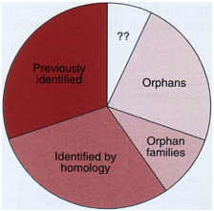
Sequencing complete vs. Gene/Function known?
Bakers’ yeast--Saccharomyces cerevisiae --one of the best-characterized model organisms
In 1996, genome sequencing finished
Yeast genome contains over 6000 genes
Over 2000 genes had been characterized in traditional experiments
Nearly 1/3 were unrelated to any previously identified sequence
Notes:
Over 2000 genes had been characterized in traditional experiments
at most a few hundred more
1996 genome complete
Over 2000 genes had been characterized in traditional experiments and it was thought that genome sequencing would identify at most a few hundred more. Scientists got a shock when they found the yeast genome contained over 6000 genes, nearly a third of which were unrelated to any previously identified sequence. Such genes were described as orphans because they could not be assigned to any classical gene family .

Slide 27
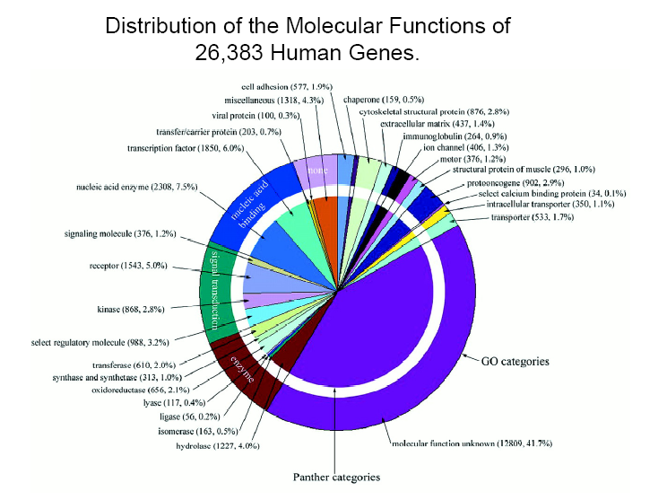
No. of genes
The HGP consortium: 31780
Celera:39114
What is new? Total number of protein-coding genes in human genome is in the range 20,000–25,000. Researchers have confirmed the existence of 19,599 protein-coding genes in the human genome and identified another 2,188 DNA segments that are predicted to be protein-coding genes ( Nature 2004, 431:931)

Slide 28
Although genetic material contains all the information required for cellular function, DNA itself does not carry out much the work in cells.
It is the products of those genes - proteins and regulatory and catalytic RNAs - that carry out the chemical and mechanical work in biological systems.

Slide 29
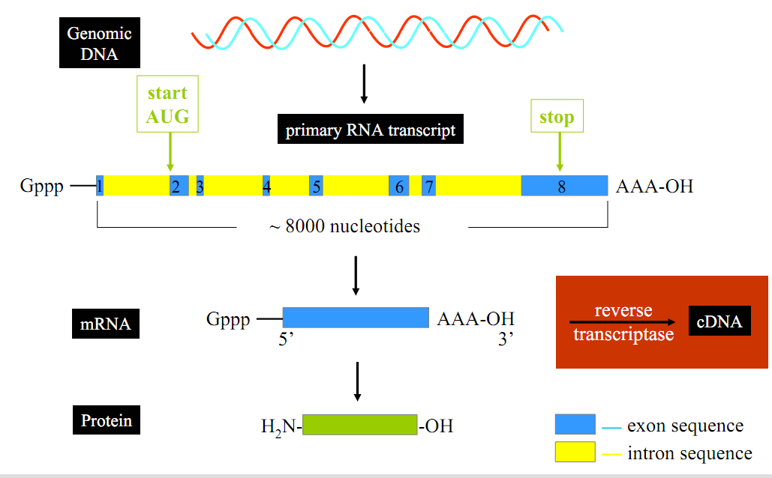
From gene to its product

Slide 30
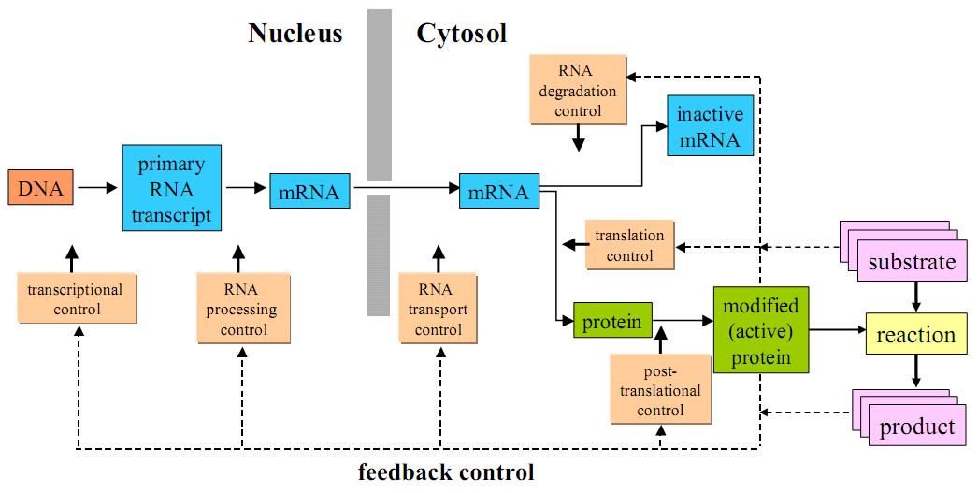
From gene to protein
Consequence: protein expression is usually poorly correlated with mRNA expression level
(Griffin, et al., Mol. Cell. Proteomics, 2002, 1, p. 323-333)
Additionally, measured metabolic fluxes are usually poorly correlated with transcript and protein level of relevant enzymes
(Ideker, et al., Science, 2001, 292, p. 929-934)
Notes:
Limits of mRNA level studies
mRNA studies can reveal protein’s amino acid sequence, start and stop codon
However information about turnover rate, post-translational modifications (phosphorylation, sulphation, glycosylation, hydroxylation, N-methylation, carboxymethylation, acylation, prenylation, and N-myristoylation) can be identified only by proteomics methods
There is a poor correlation between mRNA abundance and the amount of the corresponding protein.

Slide 31
The “ome” nomenclature…
Genome
DNA (Gene)
Transcription
Transcriptome
RNA
Translation
Proteome
PROTEIN
Enzymatic
reaction
Metabolome
METABOLITE

Slide 32
The “omics” nomenclature…
Genomics
Genome
DNA (Gene)
Transcription
Transcriptomics
Transcriptome
RNA
Functional
Genomics
Translation
Proteomics
Proteome
PROTEIN
Enzymatic
reaction
Metabolomics
Metabolitome
METABOLITE

Slide 33
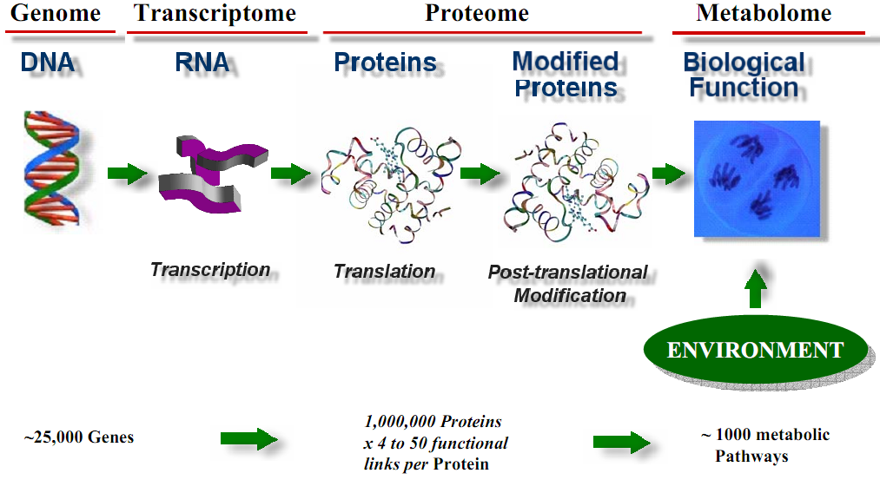
From genetic blueprint to biological function

Slide 34
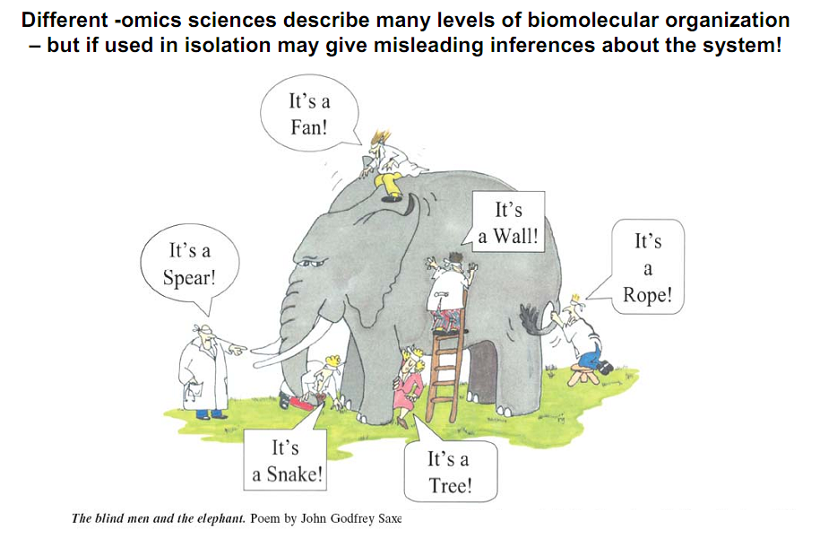

Slide 35
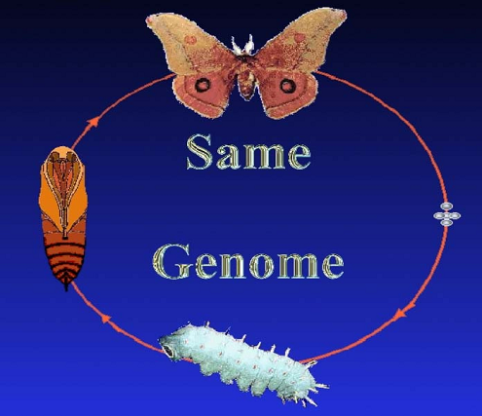
Systems Biology
The unified interconnection of multi-omics data to statistically model and predict, or dynamically simulate, and visualize functional gene - environment interactions.

Slide 36
1.2 Basic Concepts 1) genome and genomics
genome
all the genes in one cell, a virus or an organism ；one haploid set of chromosomes with the genes they contain
一个细胞、病毒或生物体所包含的全部基因。
通常在真核生物中指一个物种的单倍体染色体组所含有的一整套基因。
原核生物一般只有一个环状DNA分子，其上含有的基因为一个基因组。

Slide 37
genomics
the study of genome；a branch of biotechnology concerned with applying the techniques of genetics and molecular biology to the genetic mapping and DNA sequencing of sets of genes or the complete genomes of selected organisms, with organizing the results in databases, and with applications of the data
从基因组整体水平上对基因的活动规律进行阐述
是指对某个生物体的所有基因进行基因作图，包括遗传图、物理图、转录本图、核苷酸序列分析、基因定位和功能分析的一门学科。
具体研究内容为结构基因组学、比较基因组学、功能基因组学

Slide 38
2) transcriptome and transcriptomics
Transcriptome
The complete set of mRNA in any given cell
Transcriptomics
The study of transcriptome
The study of mRNA expression profiles on a global scale in order to reveal gene’s role in the cell and to help to identify functional links between genes.
Notes:
For example, the expression of many genes is restricted to specific cells or developing structures, often showing that the genes have particular functions in those places. Other genes are expressed in response to external stimuli. For example, they might be switched on or switched off in cells exposed to endogenous signals such as growth factors or environmental molecules such as DNA-damaging chemicals.

Slide 39
RNA-Seq
RNA sequencing, also called whole transcriptome shotgun sequencing (WTSS)
uses next-generation sequencing (NGS) to reveal the presence and quantity of RNA in a biological sample at a given moment in time.
first used in 2013.

Slide 40
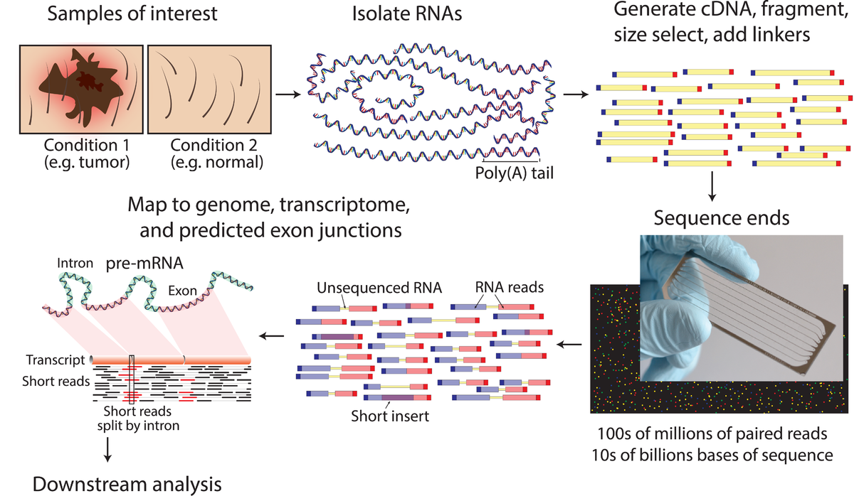
RNA-Seq
In addition to mRNA transcripts, RNA-Seq can look at different populations of RNA to include total RNA, small RNA, such as miRNA, tRNA, and ribosomal profiling

Slide 41
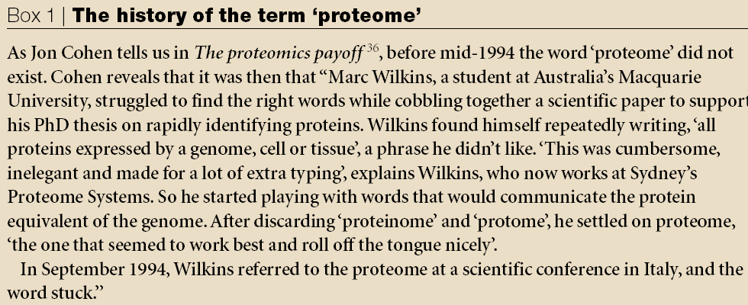
3) Proteome and proteomics

Slide 42
Proteome
a complete set of proteins expressed in acell, tissue or organism by a given genome
定义：蛋白质组是由一个细胞，一个组织或一个机体的基因组所表达的全部相应的蛋白质。是一个整体概念。
More specifically, the set of expressed proteins by a given type of cells or an organism under defined conditions

Slide 43
Proteomics
a branch of biotechnology concerned with applying the techniques of molecular biology, biochemistry, and genetics to analyzing the structure, function, and interactions of the proteins produced by the genes of a particular cell, tissue, or organism, with organizing the information in databases, and with applications of the data
the systematic, large-scale analysis of protein’s
Expression levels
Post-translational modifications (PTM)
Activities (function)
Location
Interactions (complex formation), etc

Slide 44
4) Metabolome & Metabolomics
Metabolome
a complete set of metabolites (small-molecule chemicals),such as sugars and fats, within a cell, tissue, or organism
Metabolomics
The study of a complete set of metabolites within a cell, tissue, or organism
the scientific study of chemical processes involving metabolites

Slide 45
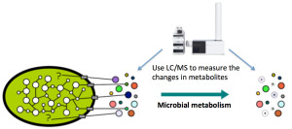
Exometabolomics
also called "metabolic footprinting"
the study of extracellular metabolites
a sub-field of metabolomics.

Slide 46

5) Comparison of genome, transcriptome and proteome
 | genome | transcriptome | proteome
Simarities | Total concept, connect by central dogma
Difference | Gene | mRNA | protein
 | static | dynamic | dynamic
 | simple | complex | complex,

Slide 47

Static
With few exceptions, genome remains the same regardless of cell type or environmental condition
一个有机体从它的发生、发展到衰老、死亡，不同细胞、组织和器官的基因组是基本稳定不变的

Slide 48

Dynamic
The content of transcriptome and proteome can fluctuate dramatically under different conditions due to the regulation of transcription, RNA processing, protein synthesis and protein modification.
转录组和蛋白质组作为基因组转录、表达的产物，随时间、地点、环境等条件变化而变化

Slide 49
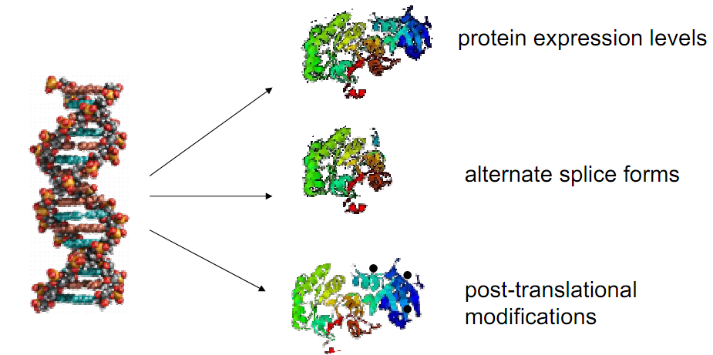
Complex
The content of transcriptome or proteome is different depends on cells, tissues and organisms
A single gene can produce many different mRNAs and proteins
Differs from cell to cell
Notes:
Genome is defined by the sequence of nycleotides. The proteome cannot be limited to the sum of the sequences of the proteins present.knowledge of proteme requires knowledge of 1) the structure of the proteins in the proteome;2) the functional interaction between the proteins.

Slide 50
Complexity of the protein world
DNA : 4 Nucleotides
Proteins : 20 amino acids
one gene –one protein ? No!
RNA Splicing→one gene, different transcripts→one gene different proteins
Post-translational modifications→one transcript, different proteins
Phosphorylation
Maturation
Glycosylation…
……
Proteome, unlike the genome, is not a fixed feature of an organism
Environmental stress

Slide 51
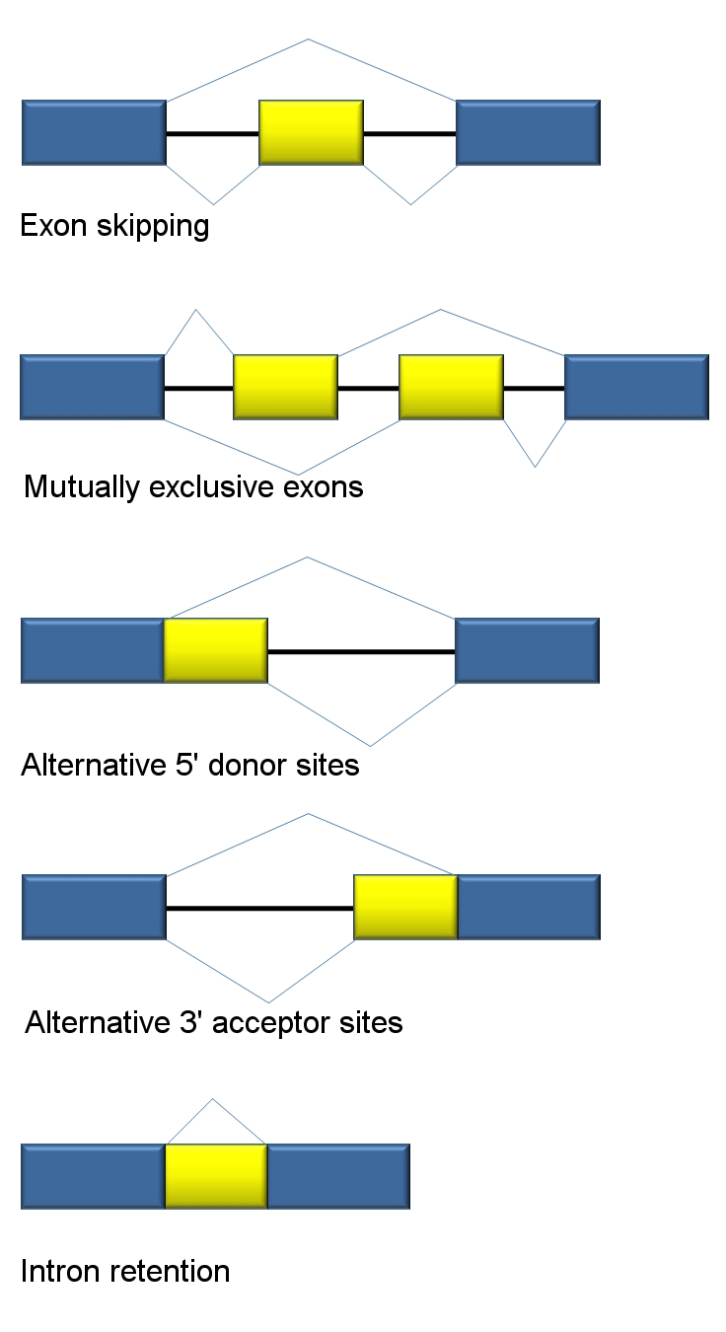
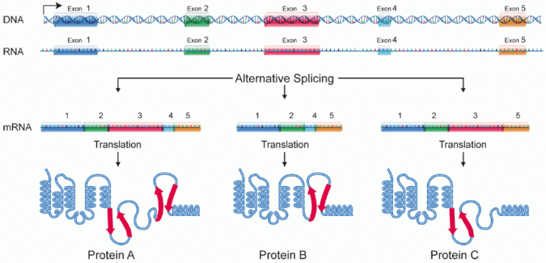


alternative splicing

Slide 52









One gene→ different transcripts
alternative splicing
alternative promoter
Different transcripts
polyadenylation site usage
special processing strategies (RNA editing etc)

Slide 53






One transcript→Different proteins
alternative usage of start and stop codons
Modifications during translation
Different proteins
Modifications after translation
http://www.biochem.mpg.de/pressroom/Archiv/2011/058_jentsch_hub1.html
Notes:
Same gene, different results

Slide 54











Proteins can be modified by different ways
Permanent & transient
One protein different modification
Eg: 1) 70% of human proteins are glycosylated
2) glycan chains have many different structures
3) same protein has several glycosylation sites
4) different glycan chains can be added to one site

Slide 55
Homework
Please find the mechanisms of how one gene can produce different proteins
Why one gene may produce several, functionally different proteins?
Why an mRNA produced in abundance results in a small amount of protein?
Notes:
An mRNA produced in abundance may be degraded rapidly or translated inefficiently, resulting in a small amount of protein.

Slide 56

1.3 Why proteomics? (Importance of proteome study)
Importance of proteins
Proteins are the mediators of functions in the cell
Different proteins: enzymes, carrier proteins, structural proteins, hormones, antibodies, etc
Most Cell development processes are controlled by protein-protein interactions
Proteins are involved in almost all cellular processes and fulfill many functions
Functional proteins: enzyme catalysis, transport, mechanical support, organelle constituents, storage reserves, metabolic control, protection mechanisms, toxins, and osmotic pressure
Deviations from normal status denotes disease
Proteins are drug / therapeutic targets

Slide 57
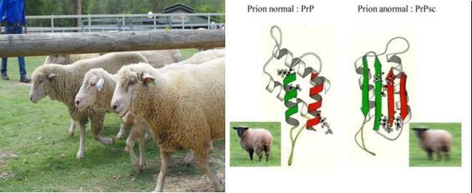

Advantages of whole genome sequence complete
Huge Information
Limits of whole genome sequence
genome sequence --complete, does not show how proteins function or biological processes occur
the function of a protein depends on its structure and interactions, neither of which can be predicted accurately based on sequence information alone
https://baike.baidu.com/tashuo/browse/content?id=c9fdac1dc071bad1280ac937&fr=qingtian&lemmaId=619278
Notes:
Limitations of genomics and proteomics studies
the level of transcription of a gene gives only a rough estimate of its level of translation into a protein.[14] An mRNA produced in abundance may be degraded rapidly or translated inefficiently, resulting in a small amount of protein.
as mentioned above many proteins experience post-translational modifications that profoundly affect their activities; for example, some proteins are not active until they become phosphorylated. Methods such as phosphoproteomics and glycoproteomics are used to study post-translational modifications.
many transcripts give rise to more than one protein, through alternative splicing or alternative post-translational modifications.
many proteins form complexes with other proteins or RNA molecules, and only function in the presence of these other molecules.
protein degradation rate plays an important role in protein content.
Prions are misfolded proteins which characterize several fatal neurodegenerative diseases in animals and humans.^{[1]}It is not known what causes the normal protein to misfold; the abnormal 3-D structure is suspected of conferring infectious properties.

Slide 58

Limits of whole genome sequence (continued)
Limit relationship among DNA, RNA and protein
Number
There is no 1:1 correspondence between number of genes and proteins
The ~25000 genes of the human genome are speculated to give rise to ~1X10⁶ proteins
Protein level of same amount mRNA may be different up to 50-fold
Same amount of protein may be the expression result of mRNA with 40-fold abundance difference

Slide 59


Limits of whole genome sequence (continued)
Limit relationship among DNA, RNA and protein
Characterization: modification
Protein post-translational modifications are not predictable from the level of the corresponding transcript
The function of a protein often depends on its localization
Some biological samples do not contain nucleic acids

Slide 60


Importance of protein study itself
Proteome reflect the biosystem status dynamicity
Proteome differs at the specific period of the cell cycle, at different stages of differentiation, corresponding to the growth and nutritional status, temperature, stress and pathological status
Regulation process in which protein synthesis, degradation, processing, modification, can only directly analyze the proteins
Post-translational modification
proteins sometimes chemically modified or regulated after synthesis
Proteins fold into specific 3-D structures which determine function
Gain insight into alternative splicing
Aids in genome annotation
etc

Slide 61
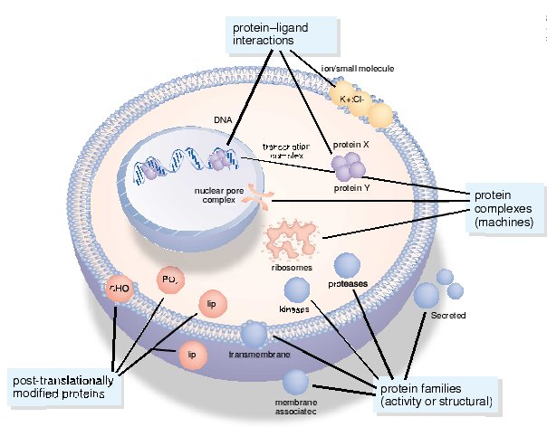
1.4 Tasks of Proteome study
Detection
What and where
PTM
Quantification
compare dynamics
Function
interaction with each other
Notes:
阐明生命细胞代谢，信号传导和调控网络的组织结构和动力学，并理解这些网络是如何在病理或生理镇南关执行功能，又如何通过干预（如药物和基因）改变他们的功能

Slide 62

1.5 Branches of proteomics
Sequence proteomics
Structural proteomics
Expression proteomics
Interaction proteomics
Cellular proteomics
Functional proteomics
glycoproteomics
phosphorproteomics

Slide 63
Sequence proteomics
Large-scale searching databases for possible protein or peptide matches, or functional assignment of domains, prediction of function from sequence, and evolutionary relationships of protein
Including
Protein sequences translated from DNA sequences
Protein structure prediction
Inferring function from sequence and structure
Challenges in comparative modeling
Protein-protein interactions prediction
Notes:
146 published completely sequenced genomes, 344 ongoing prokaryotic and 243 ongoing eukaryotic sequencing projects. A large proportion, typically 30-40% of the predicted protein coding regions of these organisms' genomes code for proteins of unknown function.

Slide 64
Three primary nucleic acid sequence databases: Genbank, the EMBL nucleotide sequence database, and the DNA database of Japan (DDBJ).
Protein sequence databases: SWISS-PROT, TrEMBL, PIR(Protein Information Resource) and NRL3D
SWISS-PROT,
founded in 1986
maintained by the UniProt consortium since 2002.
the manually annotated and reviewed section of the UniProt Knowledgebase (UniProtKB).
a high quality annotated and non-redundant protein sequence database
TrEMBL
automatic translations of the nucleotide sequences in the EMBL database
Computationally analyzed and unreviewed

Slide 65
Three primary nucleic acid sequence databases: Genbank, the EMBL nucleotide sequence database, and the DNA database of Japan (DDBJ).
Protein sequence databases: SWISS-PROT, TrEMBL, PIR(Protein Information Resource) and NRL3D
NRL3D
http://www-nbrf.georgetown.edu/pirwww/dbinfo/nrl3-d.html
The primary structure sequence database of known three-dimensional structural proteins
The primary structure sequence is extracted from the three-dimensional structure database PDB.
Sequence, secondary structure, active site, binding site, modification site and other annotation information
PIR
http://pir.georgetown.edu
Established by Georgetown University
Maintained by the International Protein Information Center (PIR International).
Divided into four different parts -- PIR1, pir2, pir3 and pir4--according to the nature of data and annotation level

Slide 66
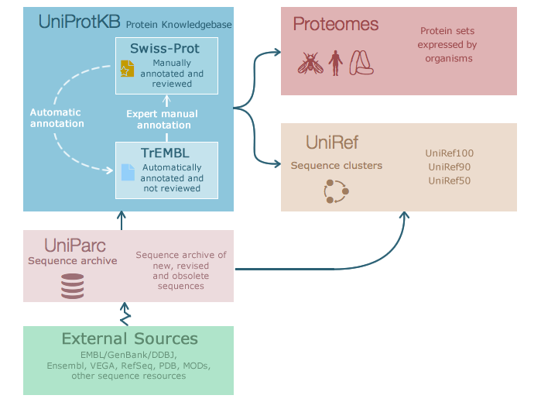

Slide 67
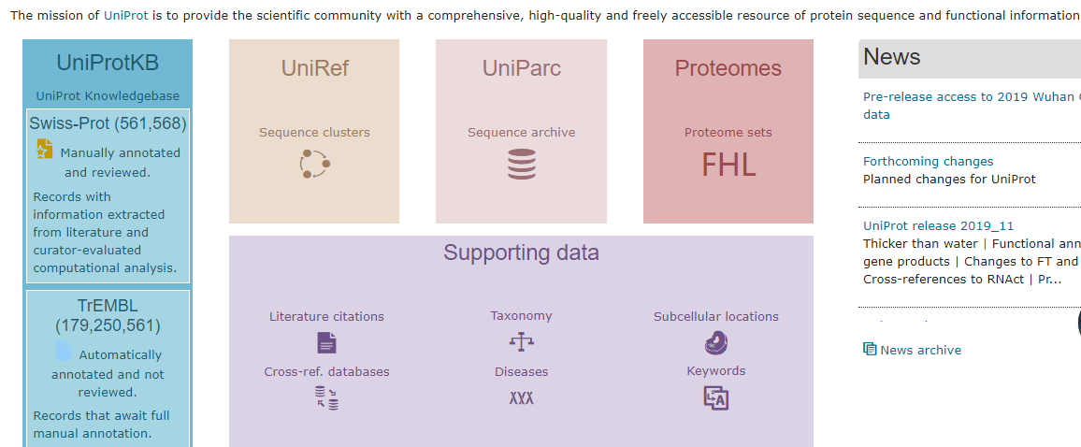
2020.2.22

Slide 68
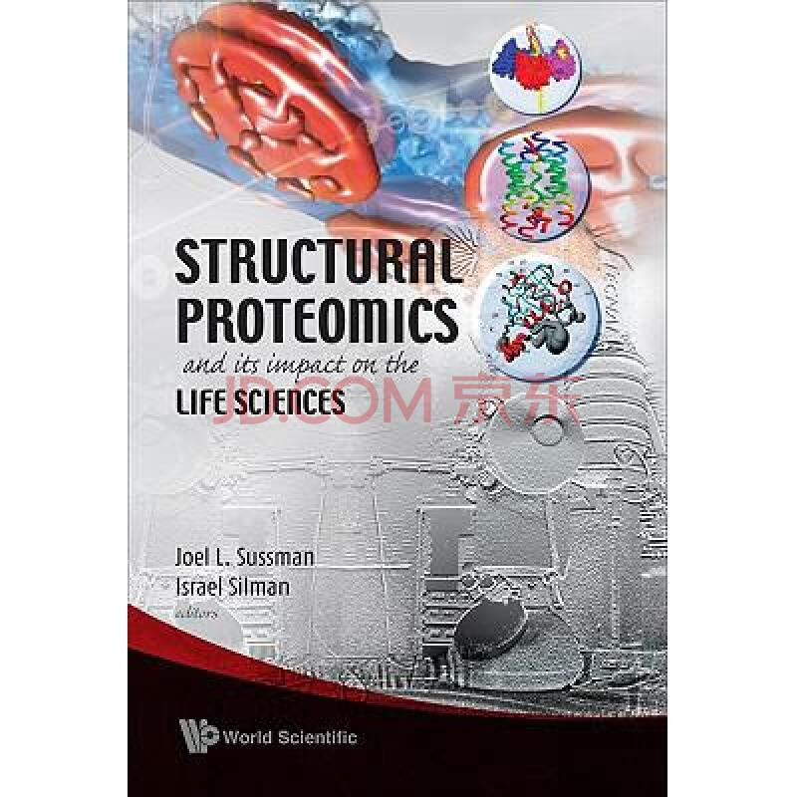
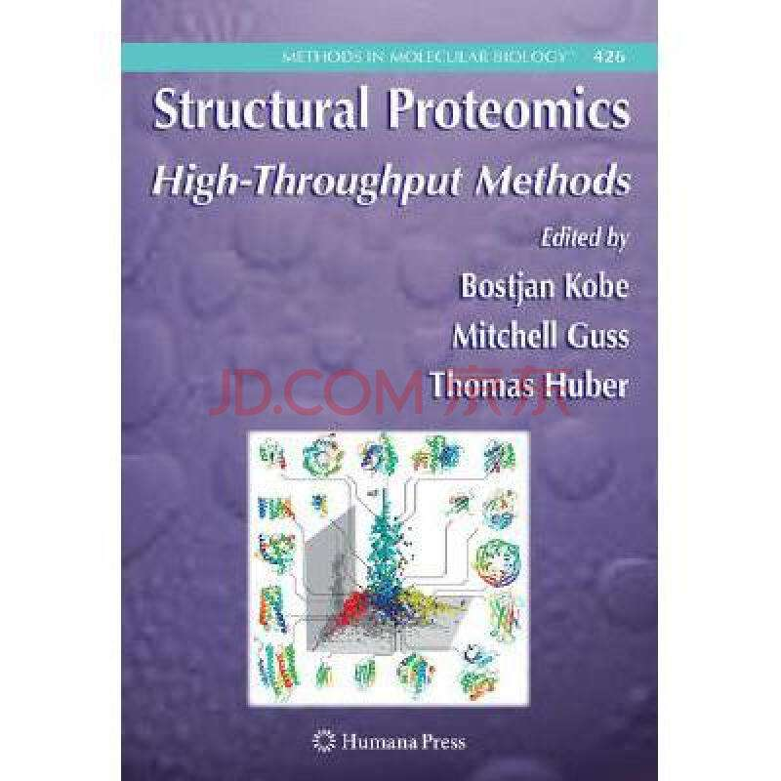

Structural proteomics
Defination
High-throughput in-depth analysis 3D structures of individual proteins, protein–protein complexes and protein–drug complexes.
Roles
inform knowledge of protein function
identify novel protein folds
identify potential targets for drug discovery
Key techniques:
Protein expression, purification and crystallization
X-ray crystallography (XRC)
Nuclear magnetic resonance （NMR）
Circular dichroism(CD)
Fourier transform infrared spectroscopy (FTIR)
Small angle x-ray scattering(SAXS)
http://www.doc88.com/p-1816407019381.html
Notes:
It has the potential to inform knowledge of protein function because protein structure is closely linked with protein function. Also it can be used to identify novel protein folds and potential targets for drug discovery.

Slide 69
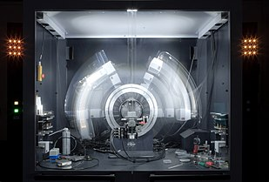

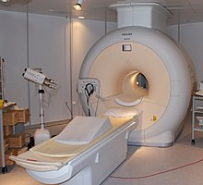
X-ray crystallography (XRC) is a technique used for determining the atomic and molecular structure of a crystal, in which the crystalline structure causes a beam of incident X-rays to diffract into many specific directions
Crystal structures of proteins (which are irregular and hundreds of times larger than cholesterol) began to be solved in the late 1950s, beginning with the structure of sperm whale myoglobin by Sir John Cowdery Kendrew, for which he shared the Nobel Prize in Chemistry with Max Perutz in 1962
Nuclear magnetic resonance (NMR) is a physical phenomenon in which nuclei in a strong static magnetic field are perturbed by a weak oscillating magnetic field (in the near field and therefore not involving electromagnetic waves) and respond by producing an electromagnetic signal with a frequency characteristic of the magnetic field at the nucleus.
NMR was first described and measured in molecular beams by Isidor Rabi in 1938, by extending the Stern–Gerlach experiment, and in 1944, Rabi was awarded the Nobel Prize in Physics for this work. In 1946, Felix Bloch and Edward Mills Purcell expanded the technique for use on liquids and solids, for which they shared the Nobel Prize in Physics in 1952.

Slide 70
X-ray crystallography (XRC) is a technique used for determining the atomic and molecular structure of a crystal, in which the crystalline structure causes a beam of incident X-rays to diffract into many specific directions
Crystal structures of proteins (which are irregular and hundreds of times larger than cholesterol) began to be solved in the late 1950s, beginning with the structure of sperm whale myoglobin by Sir John Cowdery Kendrew, for which he shared the Nobel Prize in Chemistry with Max Perutz in 1962

Slide 71
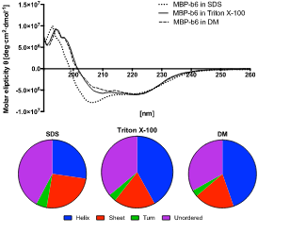
Circular dichroism (CD) is dichroism involving circularly polarized light, i.e., the differential absorption of left- and right-handed light. Left-hand circular (LHC) and right-hand circular (RHC) polarized light represent two possible spin angular momentum states for a photon, and so circular dichroism is also referred to as dichroism for spin angular momentum.
UV CD is used to investigate the secondary structure of proteins.
UV/Vis CD is used to investigate charge-transfer transitions.
Near-infrared CD is used to investigate geometric and electronic structure by probing metal d→d transitions.
Vibrational circular dichroism, which uses light from the infrared energy region, is used for structural studies of small organic molecules, and most recently proteins and DNA
CD gives less specific structural information than X-ray crystallography and protein NMR spectroscopy which both give atomic resolution data. However, CD spectroscopy is a quick method that does not require large amounts of proteins or extensive data processing.
CD can be used to survey a large number of solvent conditions, varying temperature, pH, salinity, and the presence of various cofactors.
CD spectroscopy is usually used to study proteins in solution, and thus it complements methods that study the solid state.
Notes:
CD spectroscopy is usually used to study proteins in solution, and thus it complements methods that study the solid state. This is also a limitation, in that many proteins are embedded in membranes in their native state, and solutions containing membrane structures are often strongly scattering. CD is sometimes measured in thin films.

Slide 72
Fourier transform infrared spectroscopy (FTIR) is a technique used to obtain an infrared spectrum of absorption or emission of a solid, liquid or gas.
Small-angle X-ray scattering (SAXS) is a small-angle scattering technique by which nanoscale density differences in a sample can be quantified. This means that it can determine nanoparticle size distributions, resolve the size and shape of (monodisperse) macromolecules, determine pore sizes, characteristic distances of partially ordered materials, and much more.
In biological applications SAS is used to determine the structure of a particle in terms of average particle size and shape

Slide 73


Expression proteomics
Also called quantitative regulation proteomics,
large-scale separation, identification and characterization of proteins
analysis of expression and differential expression of proteins
Including:
the analysis of protein abundance
the separation of complex protein mixtures
the identification of individual components
their systematic quantitative analysis
http://www.expressionproteomics.com/B2B/vanity/pfamily/home.do?root=/Product%20Family/XP/Home
Notes:
If a protein is found only in a diseased sample then it can be a useful drug target or diagnostic marker. Proteins with same or similar expression profiles may also be functionally related.

Slide 74
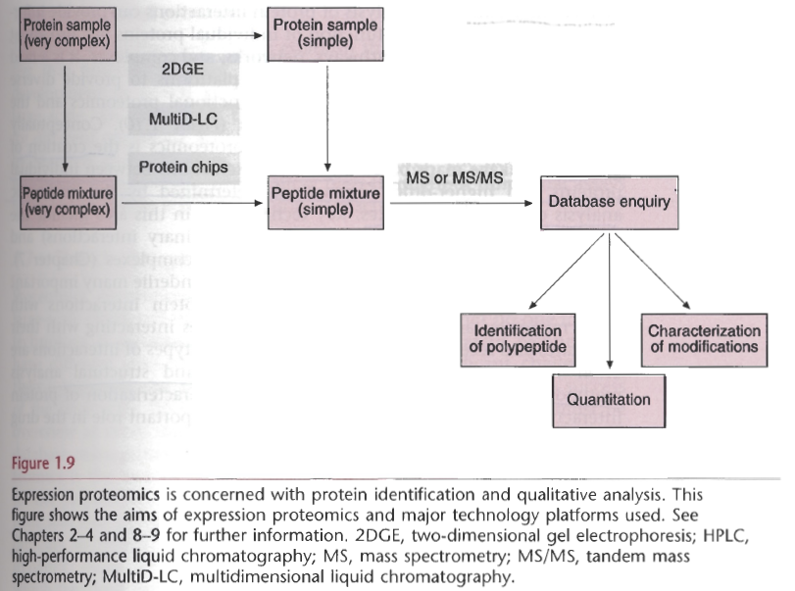

Bottom-up approach
Top-Down approch
Notes:
Bottom-up: Determining the whole from the sum of its parts

Slide 75
Bottom-up proteomics
Also called shotgun proteomics
Determining the whole from the sum of its parts
First, digest the protein to its peptide components,
typically using trypsin
Next, separate those components using liquid chromatography (LC)
Then, identify the peptides by MS, such as ESI-MS, Orbitrap MS
Finally, the resulting sequence data are used to determine the original components of the sample.

Slide 76
Top-down Proteomics
Top-Down approach: whole protein assay
the ionization of intact proteins ; MS or MS/MS analysis of intact species or fragment ions generated in mass spectrometer by induced dissociation.
Allow for high specificity protein identification and characterization of different proteoforms，which may be lost with protein digestion and unattainable with other large scale, whole proteome approaches.
Major obstacle problem --sample complexity (multitude of different proteins and their proteoforms);
Key: extensive separation and/or enrichment step preceding mass analysis
Proteomic Profiling and Analytical Chemistry (Second Edition) The Crossroads. 2016, Pages 175-191

Slide 77
Key Technologies
Sample preparation
Protein separation
2D-gel electrophoresis
multidimensional liquid chromatography
capillary electrophoresis
Protein identification
Mass spectrometry
Sequencing
Protein quantification/quantization
image analysis
mass spectrometry

Slide 78

Quantitative proteomics
It is an analytical chemistry technique for determining the amount of proteins in a sample.
The methods for protein identification are identical to those used in general (i.e. qualitative) proteomics, but include quantification as an additional dimension.
Rather than just providing lists of proteins identified in a certain sample, quantitative proteomics yields information about the physiological differences between two biological samples. For example, this approach can be used to compare samples from healthy and diseased patients.
Key techniques
two-dimensional gel electrophoresis (2-DE)
mass spectrometry (MS)
quantitative dot blot (QDB) analysis

Slide 79
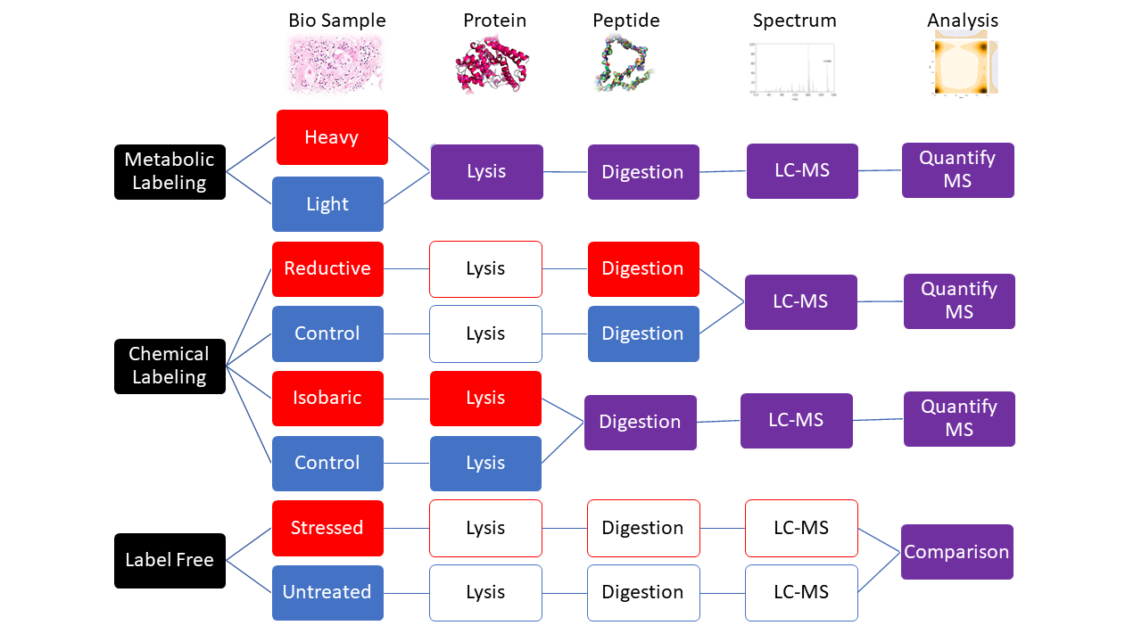
Quantitative proteomics

Slide 80
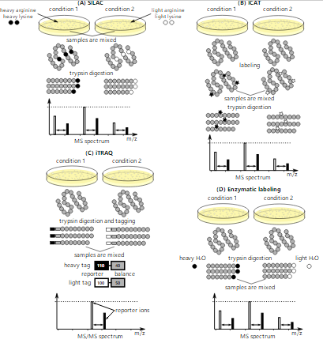
Quantitative proteomics

Slide 81
Interaction proteomics
Analysis of interactions between proteins to characterize complexes and determine function
Analysis of interactions between proteins, protein and nucleic acid, or protein and small molecules to characterize complexes and determine function
The investigation of protein interactions may be on the atomic, molecular and cellular levels
Including:
genetic and physical interactions among proteins
interactions between proteins and nucleic acids
interactions between proteins and small molecules
protein
protein
Nucleic acid
Small molecules

Slide 82
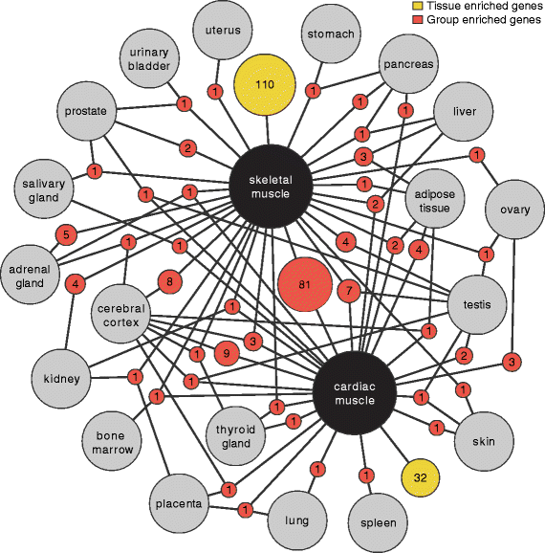
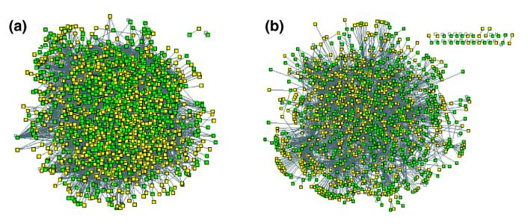

Goal of interaction proteomics
The function of individual protein
How proteins function in pathways, networks, and complexes
Creation of proteome linkage maps based on binary interactions between individual proteins and higher-order interactions determined by the systematic analysis of protein complexes
Help understanding gene regulation
Drug development process

Slide 83

Key technologies
Yeast two-hybrid system
Protein chip
Mass/tandem mass spectrometry for the analysis of protein complexes
High-throughput imaging (HTI)
Biochemical assays and structural analysis methods (e.g., X-ray crystallography,& NMR) for protein-ligand interaction study

Slide 84
Cellular proteomics
Map location of proteins and protein-protein interactions during key cell events.
Techniques
X-ray Tomography
optical fluorescence microscopy.
Notes:
X-ray Tomography: X线断层摄影术

Slide 85
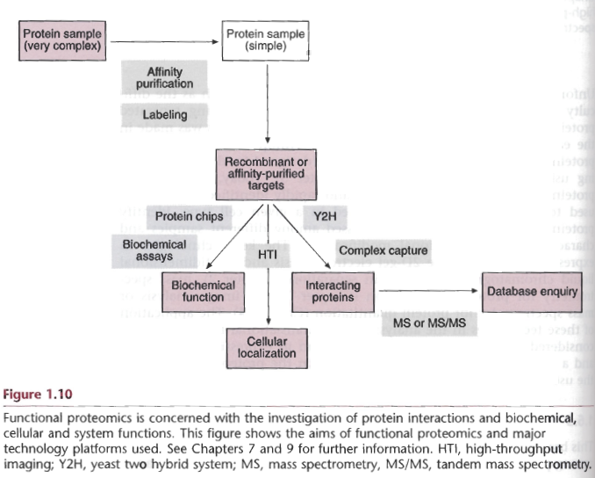
Functional proteomics
Test protein functions directly and on a large scale
Key technologies
Functional protein chips

Slide 86
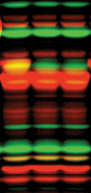
Activity-based proteomics
also called activity-based protein profiling (ABPP)
It is a functional proteomic technology that uses chemical probes that react with mechanistically related classes of enzymes
The basic unit of ABPP is the probe typically consisting of two elements: a reactive group (RG, sometimes called a "warhead") and a tag.
Some probes may contain a binding group which enhances selectivity.
The reactive group(RG) usually contains a specially designed electrophile that becomes covalently-linked to a nucleophilic residue in the active site of an active enzyme. An enzyme that is inhibited or post-translationally modified will not react with an activity-based probe.
The tag may be either a reporter such as a fluorophore or an affinity label such as biotin or an alkyne or azide for use with the Huisgen 1,3-dipolar cycloaddition (also known as click chemistry)

Slide 87
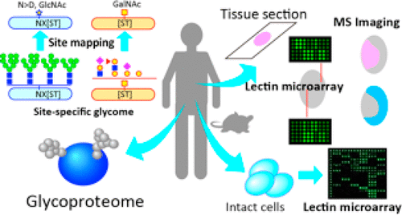
Glycoproteomics
It is an important recent advance in the field of glycoscience.
It is a branch of proteomics that identifies, catalogs, and characterizes proteins containing carbohydrates as a result of posttranslational modification.
In glycomics, glycan structures are comprehensively analyzed after glycans are released from glycoproteins (Mass spectrometry is commonly used)
However, a major limitation of glycomics is the lack of insight into glycoprotein functions
Glycoproteomics technologies aimed at obtaining a comprehensive understanding of intact glycoproteins, i.e., the kind of glycan structures that are attached to particular amino acids and proteins, have been developed
Current Technologies for Complex Glycoproteomics and Their Applications to Biology/Disease-Driven Glycoproteomics
Journal of Proteome Research ( IF 3.95 ) Pub Date : 2018-10-25 , DOI: 10.1021/acs.jproteome.8b00515
Notes:
pGlyco 2.0 enables precision N-glycoproteomics with comprehensive quality control and one-step mass spectrometry for intact glycopeptide identification

Slide 88
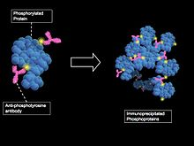
Phosphoproteomics
It is a branch of proteomics that identifies, catalogs, and characterizes proteins containing a phosphate group as a posttranslational modification.
Compared to expression analysis, phosphoproteomics provides two additional layers of information
what protein or pathway might be activated because a change in phosphorylation status almost always reflects a change in protein activity.
what proteins might be potential drug targets as exemplified by the kinase inhibitor Gleevec.
Key Technologies
Enrichment phosphoproteins and phosphopeptides
fractionation phosphoproteins and phosphopeptides
selectively visualize phosphorylated residues
identification
Recent findings and technological advances in phosphoproteomics for cells and tissues[J]. Expert review of proteomics, 2015, 12(5): 469-487.
Identifying Novel Signaling Pathways: An Exercise Scientists Guide to Phosphoproteomics[J]. Exercise and sport sciences reviews, 2018, 46(2): 76-85.
Notes:
Phosphorylation is a key reversible modification that regulates protein function, subcellular localization, complex formation, degradation of proteins and therefore cell signaling networks.
With all of these modification results, it is estimated that between 30%–65% of all proteins may be phosphorylated, some multiple times. Based on statistical estimates from many datasets, 230,000, 156,000 and 40,000 phosphorylation sites should exist in human, mouse, and yeast, respectively
Identifying Novel Signaling Pathways: An Exercise Scientists Guide to Phosphoproteomics Exercise and Sport Sciences Reviews: April 2018 - Volume 46 - Issue 2 - p 76–85
doi: 10.1249/JES.0000000000000146
Phosphoproteomics will greatly expand knowledge about the numbers and types of phosphoproteins, its greatest promise is the rapid analysis of entire phosphorylation based signalling networks

Slide 89
1.7 Application field of proteomics
Medical and medicine
Biomarker identification
Disease mechanism study
New drug design
Agriculture
Crop genetic diversity assay
Plant disease resistance related protein
Plant stress resistance related protein
Plant Immune antagonist (discovery and function)

Slide 90
1.7 Application field of proteomics
Animal [livestock] husbandry
Denetic diversity assay
Disease physiology
Stress resistance related protein
Immune antagonist (discovery and function)
Biology/microbiology
Biocontrol microorganism
Plant pathogenic microorganism
Foodborne pathogenic microorganism
Waste biodegradation microorganism
Notes:
pGlyco 2.0 enables precision N-glycoproteomics with comprehensive quality control and one-step mass spectrometry for intact glycopeptide identification

Slide 91

2019年以来 9820 篇 文献
2018年以来 26100 篇 文献
2015年以来 84500 篇 文献

Slide 92
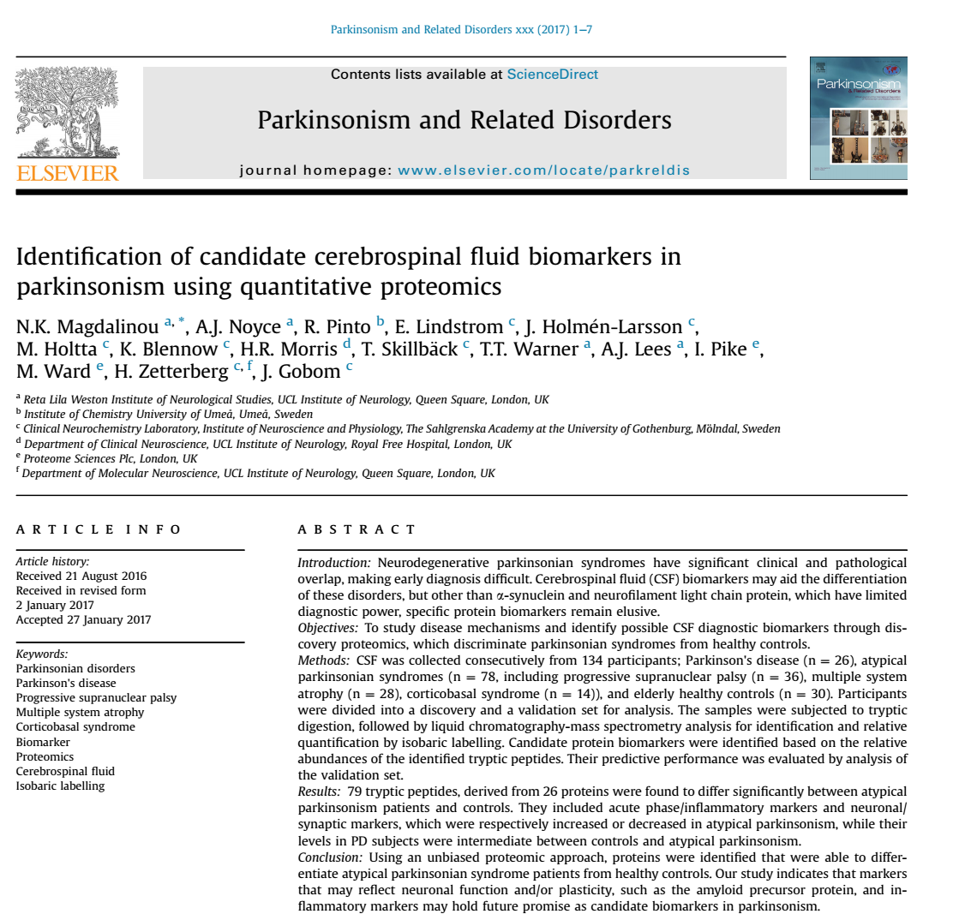

Slide 93
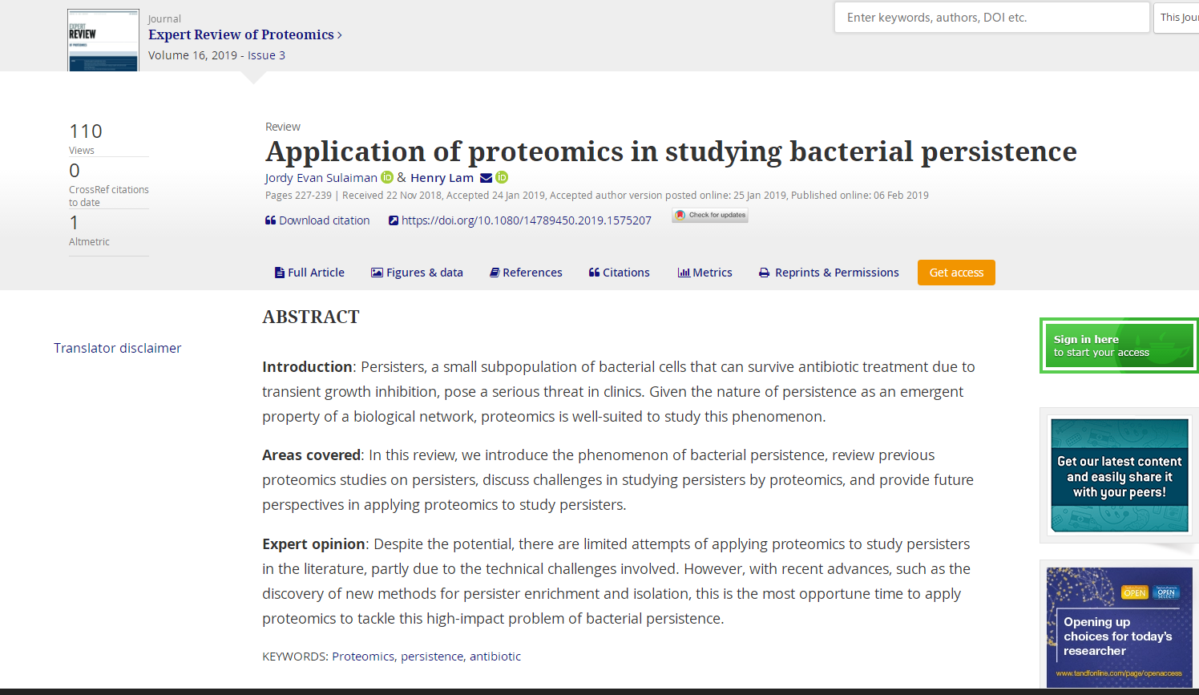

Slide 94


Slide 95


Slide 96
Questions
Describing the Meaning and Similarities and Differences of Genomes, Transcriptions and Proteomes in Brief
Why should we study proteomics? The importance and necessity of proteome research
Are there different approaches to proteomics and genomics? What are they?
What are the differences between proteome research and traditional protein research?？
What are the branches of proteomic research? What do they mean?
How can only about 35,000 human genes encode more than 100,000 proteins?
Why one gene may produce several, functionally different proteins?

Slide 97
Top-Down proteomics
Bottom-up Proteomics
Shotgun proteomics
Targeted proteomics
Quantitative proteomics
Expression proteomics
Interaction proteomics
Structural proteomics
Glycoproteomics vs Glycomics
Phosphoproteomics
Subcellular proteomics
Functional proteomics
Comparative proteomics

